Slide 1
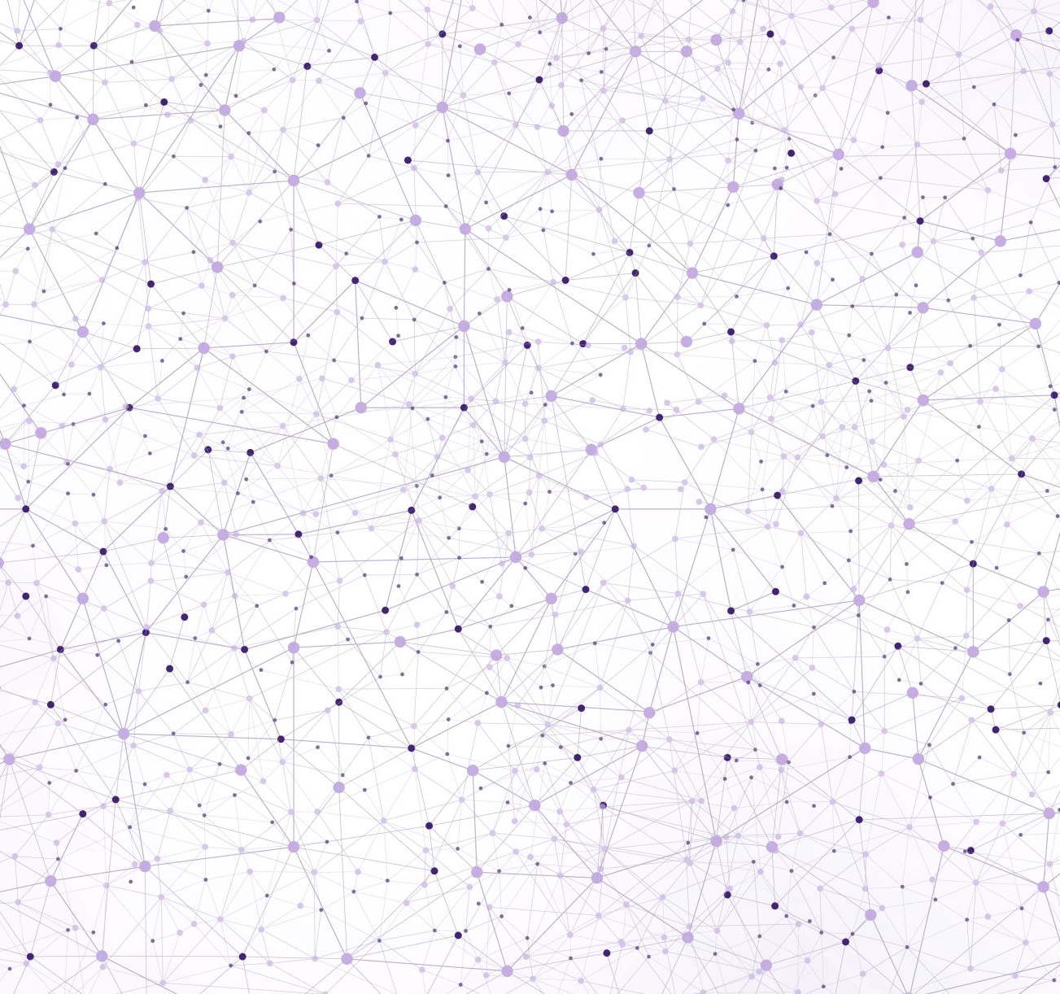
Looking at the Present Image: Understanding the YOLOv3 Algorithm
Kester Nucum ECE 4971 – Capstone II Technical Presentation February 27, 2023
Notes:
0:00-0:15
Hello everybody, my name is Kester Nucum, and I currently am on the Capstone Team for the Parking Lot Monitoring System. Today we will be looking at the present image and be understanding the YOLOv3 algorithm.

Slide 2
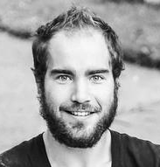
YOLOv3 Algorithm Overview
First YOLO iteration created by Joseph Redmon in 2016
PhD student under Dr. Ali Farhadi at the University of Washington
Real-time object detection algorithm
Combines feature extraction, classification, and bounding box regression in a single neural network doing one evaluation
YOLO = “You Only Look Once”
Convolutional neural network
Applies 1x1 convolutions, aka 1x1 kernel on a feature map (simple single-stage architecture)
Very fast inference time, good for real-time systems
Predecessors: YOLO, YOLOv2
Notes:
0:15-2:00
Whether or not you live by #YOLO, it seems like the creators live by that motto. YOLO was first introduced in 2016 in a paper by Joseph Redmon, who was a PhD student under Dr. Ali Farhadi at the University of Washington. YOLO is a real-time object detection algorithm, and was revolutionary at the time because it combines feature extraction, classification, and bounding box regression all into a single neural network. In other words, prior to the YOLO algorithm, all of these tasks were separate. There was a separate module that extracted features such as edges and colors from the image, another that made sense of those features and classified the objects into categories, and another to create bounding boxes that essentially pinpoint where the objects are at. Sounds complicated? Well, Redmon wanted to simplify this by combining all of these tasks into a single convolutional neural network that performs a single evaluation across an image. YOLO stands for “You Only Look Once,” a reference to this exact architecture and how the algorithm applies a 1x1 convolution to the entire image (1 pixel by 1 pixel). This architecture allows for the algorithm to have a very fast inference time at also a high accuracy.

Slide 3
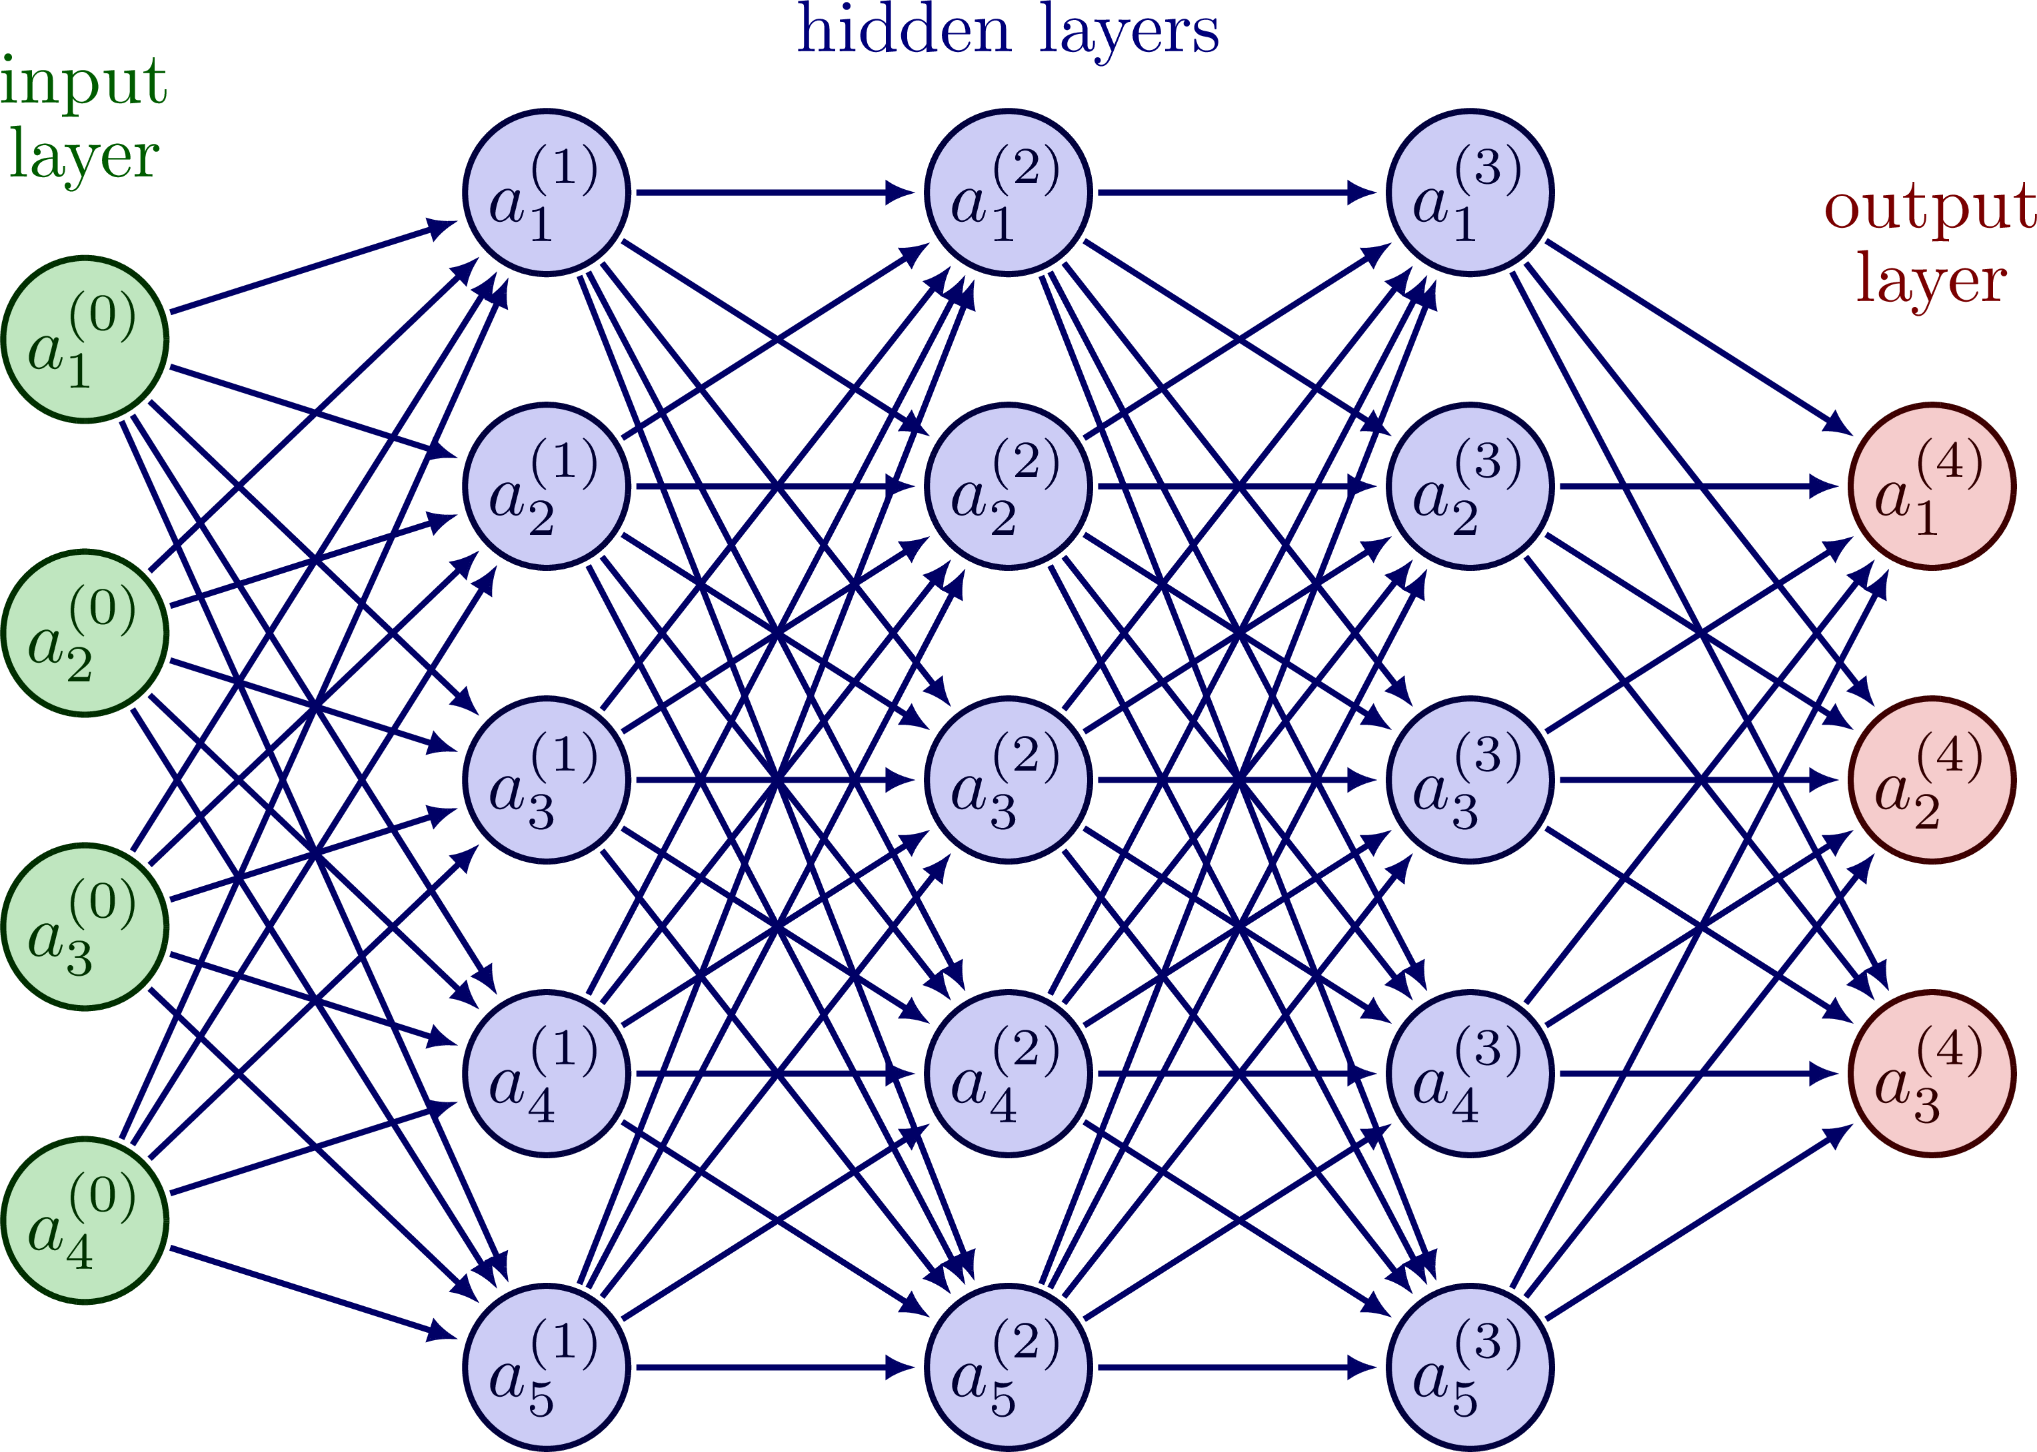
Neural Network
Subset of machine learning and deep learning
Models the human brain
Inputs propagate through multiple hidden layers in which each layer performs calculations on outputs from previous layers
Notes:
2:00-3:00
To explain what the YOLO algorithm is, I’m going to start from the top-level and go down. Firstly, in general, a neural network is a subset of machine learning and deep learning that is loosely based upon how the human brain takes in stimuli and propagates processes those signals through neurons throughout the brain. Taking the image to the right, in a neural network, we start at the inputs, and those inputs are sent to the next hidden layer where they are weighted and operated upon, and those sums are then sent to the next hidden layer and then operated upon. These signals are propagated throughout the neural network until they reach the final output layer. In neural networks in general, and in particular convolutional neural networks, you can think of each layer as a different representation of the original inputs, that the inputs are re-presented and re-processed again and again until we obtain the output that we need.

Slide 4
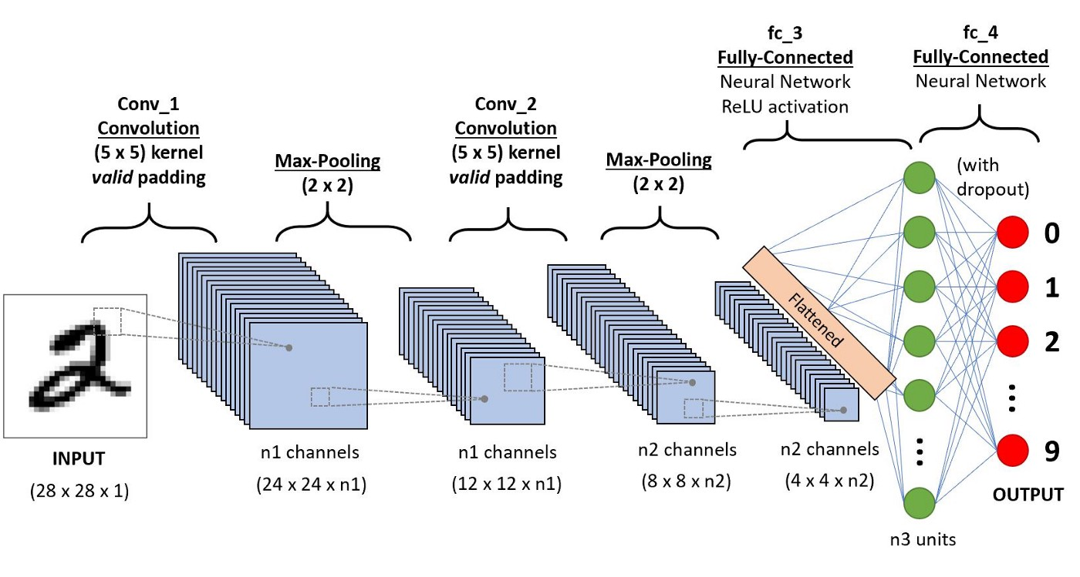
Convolutional Neural Network (ConvNet/CNN)
Takes in images as input, assigns weights to certain characteristics, and differentiates between characteristics
Convolution is applied region by region
First layers capture low-level features such as edges, color, etc.
Later layers determine high-level features, like detecting objects
Trend: Pixel -> Information
Great for image classification
Notes:
3:00-4:00
Convolutional neural networks are a specific kind of neural networks that, as the name implies, performs convolution on each layer, and I’ll explain what convolution is on the next slide. This image is a convolutional neural network in a nutshell. As you can see, there are multiple layers starting from the input image. What happens is that we take a section of that image and perform convolution upon it to glean out information, and then we take the convolution performed on that region and break it down even further and feed that into more neural networks. As you can see, there are multiple layers in which each at each layer, the data is re-presented. The first layers capturing the low-level features such as edges, color, etc. (feature identification) and later layers piece together this information to determine high-level features, like detecting objects and even classifying them. CNNs are very useful for image classification.
Images are pixels

Slide 5
Convolution
Image/Kernel Dimensions: Height x Breadth x Number of Channels
Height x Breadth = Aspect Ratio
Number of Channels = RGB, etc.
“Convolution” = “cross-correlation”
Not exactly convolution as in signal processing, but similar
Kernel – a pattern of weights replicated across multiple local regions
Convolution – applying kernel to pixels of the image
Stride - number of pixels that each kernel center is separated by
Convolving 5x5x1 image with 3x3x1 kernel with a stride of 1 to obtain 3x3x1 feature
Notes:
4:00 – 6:30
More specifically, you can say that a CNN applies a pattern of pixels and go through region by region whether or not that pattern could be found through the weights in the kernel (greatly, somewhat, or not at all). Firstly, an image and a kernel can be described in three dimensions: height x breadth x number of channels. The height x breadth is your aspect ratio, like for example if an image is 1920 by 1080 pixels. The number of channels refers to if there are multiple data points per pixel, like how for example, a single pixel in RGB has three pairs of bits: one for red, one for green, one for blue. The kernel should match the number of channels, but can have a different “aspect ratio” as you can call it.
For those who have taken signal processing, which is pretty much all of you, convolution is not exactly the same but is very similar. If you remember how in signal processing, how an output signal is found by convolving the input signal with the impulse response of a filter or system, the same process applies to image convolution. Remember the sliding tape rule. You can think of the kernel as the impulse response that is being slid over the image—the kernel is a pattern of weights replicated across multiple local regions. For example, this kernel could symbolize a pattern of pixels that applies to a car. Convolution occurs when the algorithm applies this kernel to the pixels of the image, and this kernel moves around the various regions of the image. These regions are determined by the stride, which is the number of pixels that each kernel center is separated by. Thus, the stride and kernel divides up the image into a grid (overlapping in the example or non-overlapping), and just like convolution, this kernel is applied to the region and the pixels and weights are multiplied and summed together to produce a convolved feature. To the right is an example of convolving a 5x5x1 image with a 3x3x1 kernel with a stride of 1 to obtain a 3x3x1 feature. The weights of the kernel are seen in the bottom right of the yellow squares. Convolution reduces the dimensions

Slide 6
YOLOv3 in a Nutshell
Single fully convolutional network (FCN) across the entire image
Divides image into regions/cells within a grid
Each region predicts a fixed number of bounding boxes with probabilities
Bounding box – indicates where an object is by surrounding the object
Classification – what the objects in the images are (typically general categories)
Predicted probabilities – how probable there is an object in the bounding box and it is classified correctly
Bounding Box Prediction
2 values for box center offsets (x and y)
2 values for box size scales (x and y)
1 value for objectness score
N values for scores for N number of classes to be detected
Can process inputs of any size
Uses resolution augmentation to account for varying resolutions affecting network parameters
Notes:
6:30 – 8:30
FCN – only convolutional layers

Slide 7
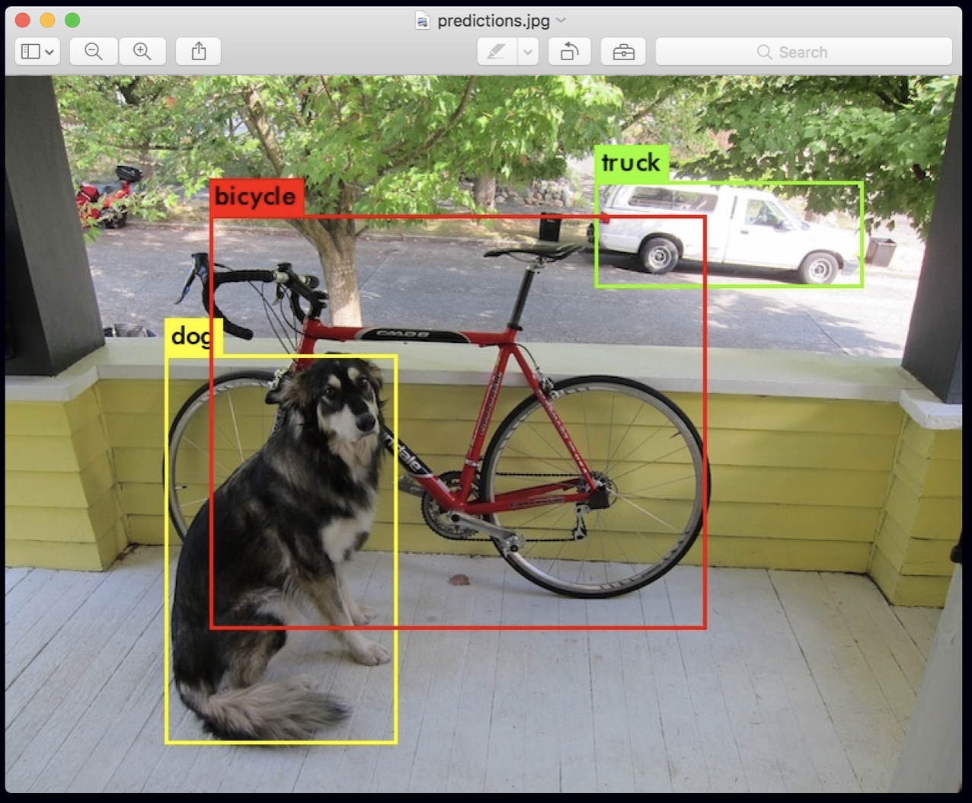
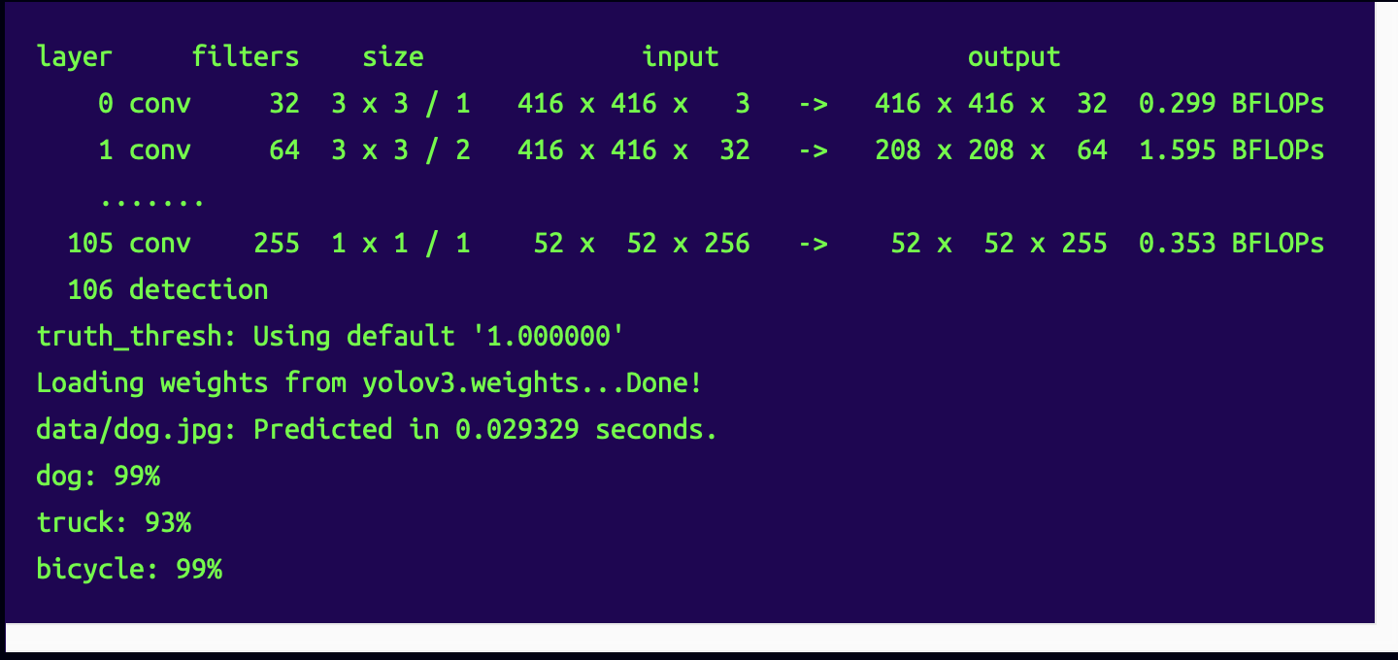
YOLOv3 Output
Notes:
8:30 – 9:45
Point out bounding boxes, image classification, and probabilities (feature extraction is the first step in making sense of the pixels)
Point out the 106 layers
Point out the speed – 0.029329 seconds

Slide 8
YOLOv3 Characteristics
1 x 1 Convolution
1 x 1 detection kernels are applied on feature map
Produced prediction map is same size as feature map
Shape of detection kernel is 1 x 1 x (B x (5 + C))
B – number of boundary boxes per cell
5 – x and y offset, x and y scale, and object presence
C – number of classes
Reduces filter dimensionality
Intersection over Union (IOU) and Non-Max Suppression
Prevents objects from being detected multiple times
Chooses the best bounding box
Boundary boxes with high predictions are final predictions
Whichever cell is at the very center of the ground truth box is responsible for predicting object presence
Predictions are made at three scales
Input image dimensions are down-sampled by 32, 16, and 8
Notes:
9:45 – 12:00

Slide 9
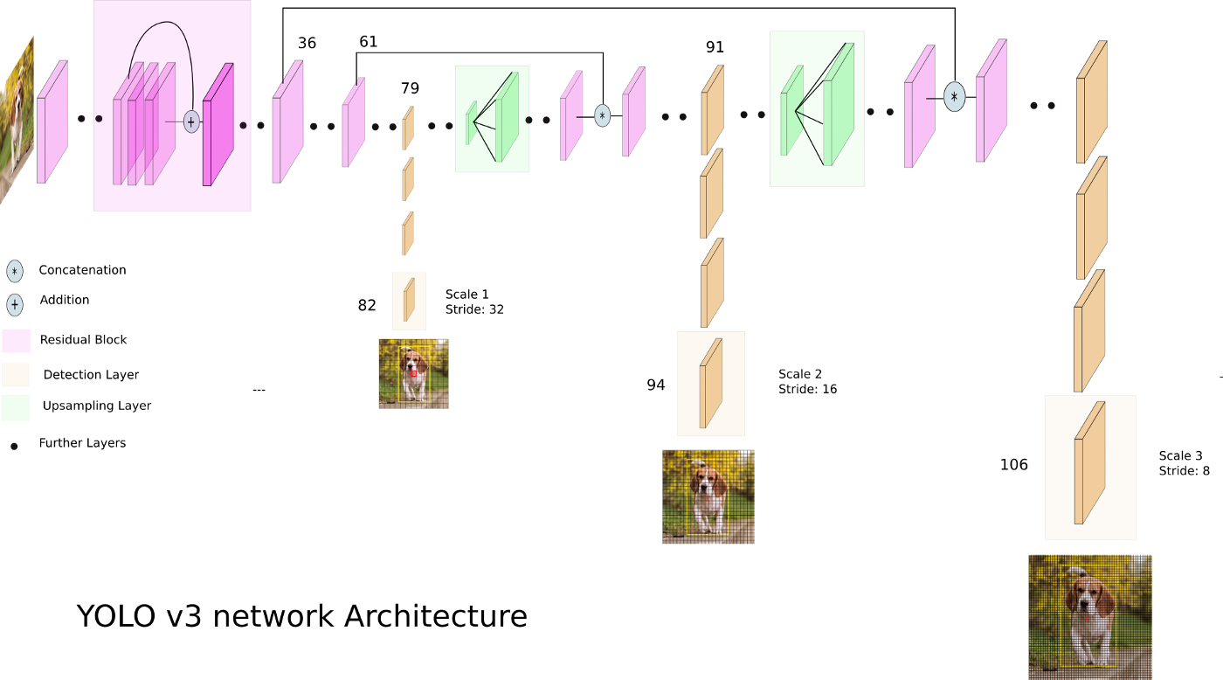
YOLOv3 Architecture
106 fully convolutional layers
53 layers from Darknet-53 for feature extraction
53 more layers for object detection
Convolves multiple filters to produce multiple feature maps
Very compact
Loss functions are very complicated
Detections at three layers
Notes:
12:00-13:00
Darknet is an open source neural network framework written in C and CUDA
Uses binary cross-entropy for calculating the classification loss for each label while object confidence and class predictions are predicted through logistic regression.

Slide 10
YOLOv3 vs. Predecessors
YOLO
Foundation of YOLO architecture, very outdated
YOLOv2
Improvements upon YOLO, particularly resolution independency
Much faster than YOLOv3 but used Darknet-16
YOLOv3 Improvements
Better at detecting smaller objects
Detections at different layers for large (13x13 layer), medium (26x26 layer), and small (52x52) objects
Uses Darknet-53 to improve accuracy (at expense of time)
10x number of bounding boxes
Multilabel classifications
There are successors (YOLOv4, YOLOv5, YOLOv7) but were not released by Redmon
Notes:
13:00-14:00

Slide 11
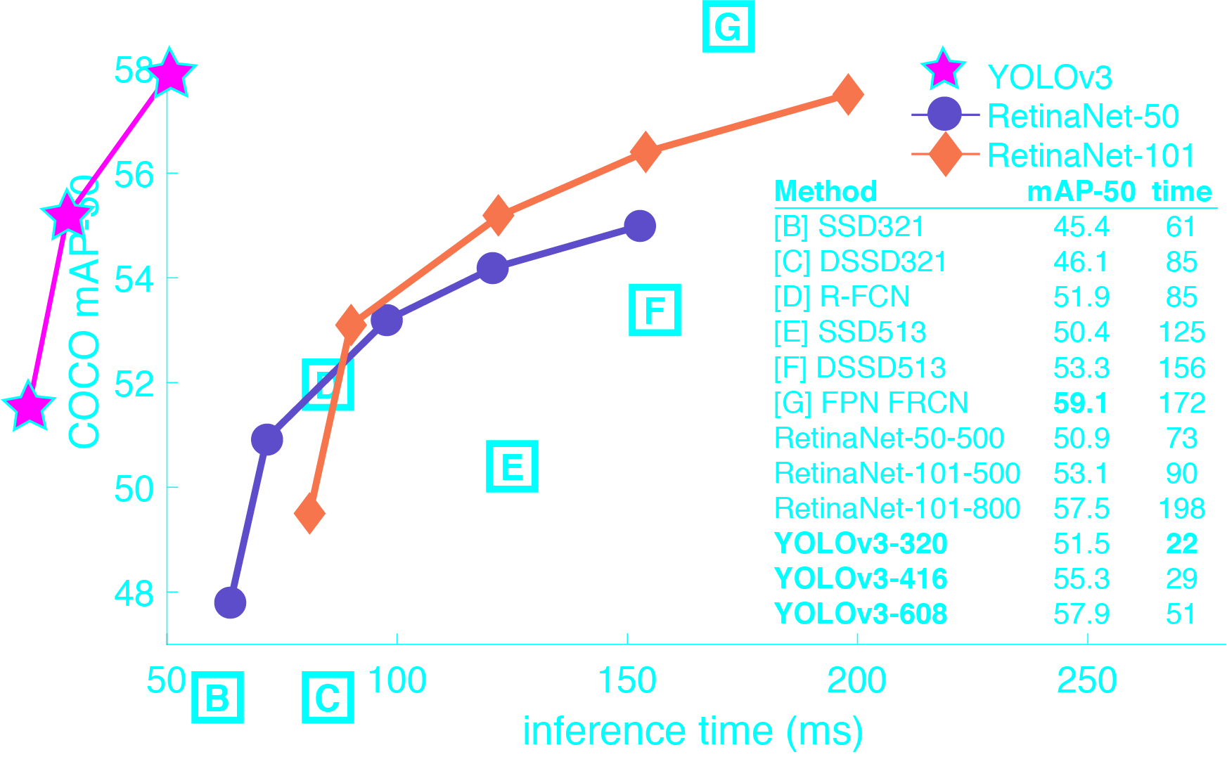
Comparisons with Other Algorithms
Speed
Very fast inference time and frames per second (fps)
30 fps on a Pascal Titan X
Highly suitable for real-time applications
Accuracy
Not the most accurate object detection algorithm, especially small objects
RetinaNet shows a higher mean-average precision (MAP)
Larger dataset increases accuracy
May not be ideal for niche models with smaller datasets
Notes:
14:00-15:00

Slide 12
References
[1] S. Russell, P. Norvig, Artificial Intelligence: A Modern Approach, 4th ed., Hoboken, NJ: Pearson Education, Inc., 2021.
[2] H. Bandyopadhyay, “What is Computer Vision? [Basic Tasks & Techniques],” V7Labs, 2 Feb. 2023, https://www.v7labs.com/blog/what-is-computer-vision.
[3] M. Memon, “ANN vs CNN vs RNN: Neural Networks,” Levity, 16 Nov. 2022, https://levity.ai/blog/neural-networks-cnn-ann-rnn.
[4] S. Saha, “A Comprehensive Guide to Convolutional Neural Networks – the ELI5 way,” Towards Data Science, 15 Dec. 2018, https://towardsdatascience.com/a-comprehensive-guide-to-convolutional-neural-networks-the-eli5-way-3bd2b1164a53.
[5] U. Almog, “YOLO V3 Explained,” Towards Data Science, 9 Oct. 2020, https://towardsdatascience.com/yolo-v3-explained-ff5b850390f.
[6] S. Shakhadri, “Implementation of YOLOv3: Simplified,” Analytics Vidhya, 11 Jun. 2021. https://www.analyticsvidhya.com/blog/2021/06/implementation-of-yolov3-simplified/.

Slide 13
References
[7] A. Chakure, “YOLOv3 (You Only Look Once) Deep Learning Algorithm,” DataDrivenInvestor, 27 Apr. 2021. https://medium.datadriveninvestor.com/yolov3-you-only-look-once-12de76ad74d5.
[8] J. Redmon, “YOLO: Real-Time Object Detection,” https://pjreddie.com/darknet/yolo/.
[9] J. Redmon, A. Farhadi, “YOLOv3: An Incremental Improvement,” arXiv, 2018.
[10] L. Tan, T. Huangfu, L. Wu, W. Chen, “Comparison of RetinaNet, SSD, and YOLO v3 for real-time pill identification,” BMC Medical Informatics and Decision Making, 2021.
[11] V. Meel, “YOLOv3: Real-Time Object Detection Algorithm (Guide),” viso.ai, https://viso.ai/deep-learning/yolov3-overview/.
[12] A. Kathuria, “What’s New in YOLO v3?,” Towards Data Science, 23 Apr. 2018. https://towardsdatascience.com/yolo-v3-object-detection-53fb7d3bfe6b.

